Slide 1
Lecture 10a.
Asynchronous Programming I

Slide 2

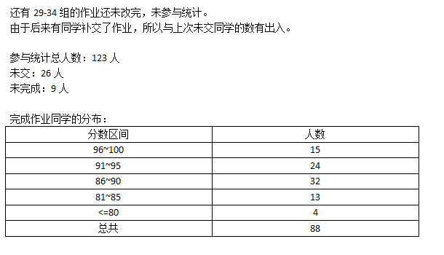




宝剑锋从磨砺出 梅花香自苦寒来

Slide 3
Outline
Ajax, Web services, REST
Async in JavaScript

Slide 4
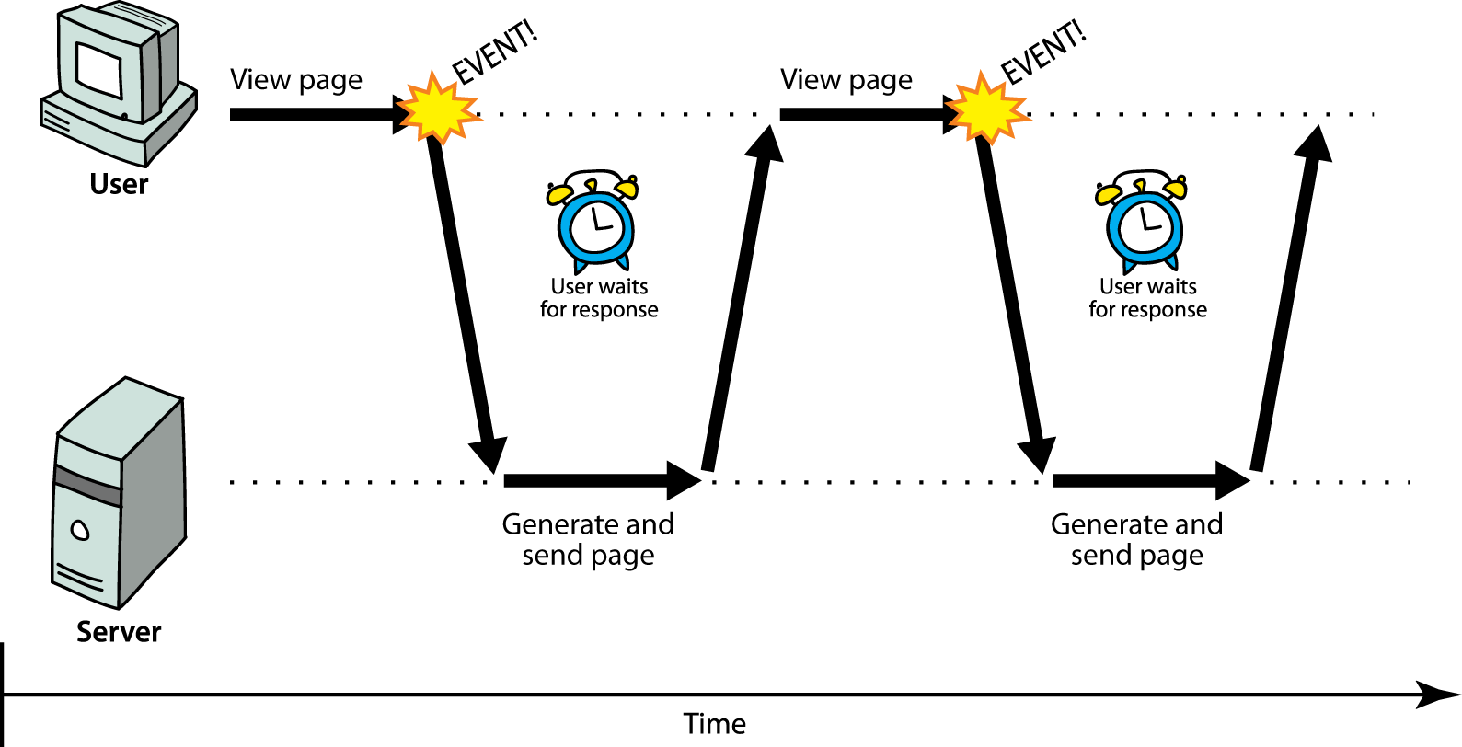
Synchronous web communication
synchronous: user must wait while new pages load
  the typical communication pattern used in web pages (click, wait, refresh)
almost all changes with new data lead to page refresh

Slide 5

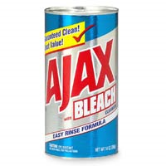
Web applications and Ajax
web application: a dynamic web site that mimics the feel of a desktop app
  presents a continuous user experience rather than disjoint pages
  examples: Gmail, Google Maps, Google Docs and Spreadsheets, Flickr
Ajax: Asynchronous JavaScript and XML
  not a programming language; a particular way of using JavaScript
  downloads data from a server in the background
  allows dynamically updating a page
  avoids the "click-wait-refresh" pattern
  examples: Google Suggest

Slide 6
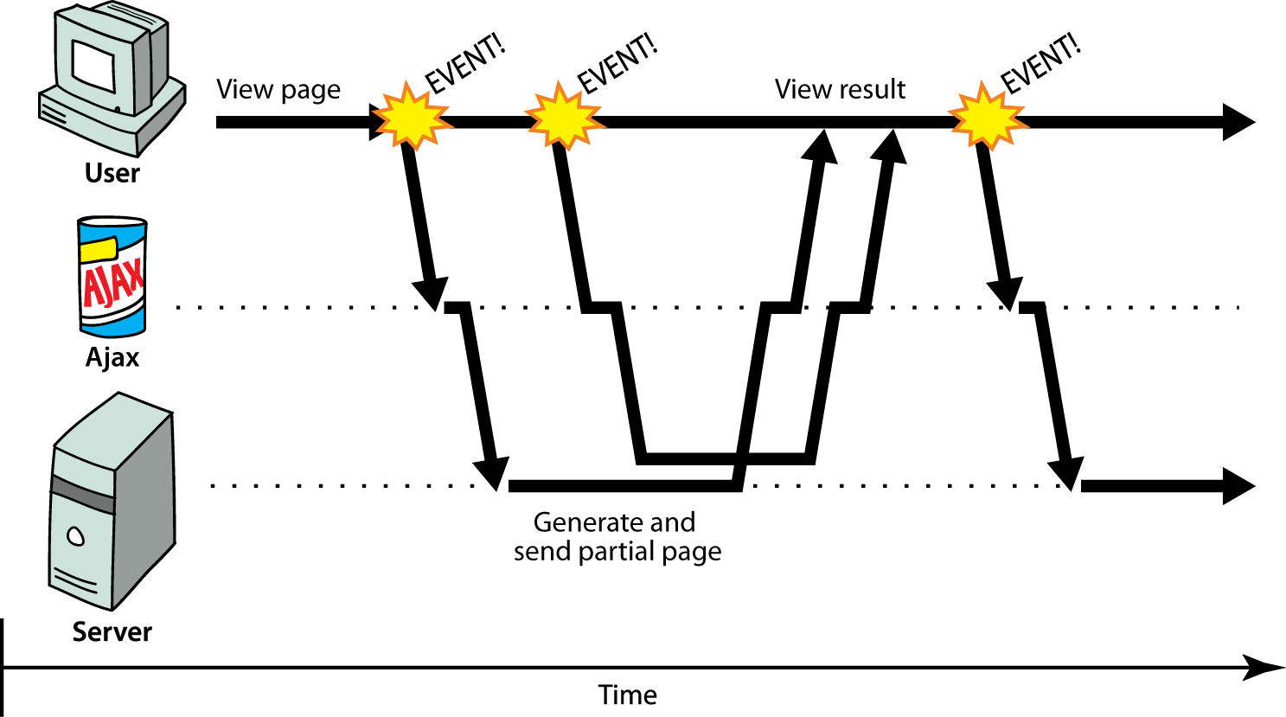
Asynchronous web communication
asynchronous: user can keep interacting with page while data loads
  communication pattern made possible by Ajax
Changing with new data but without page refresh

Slide 7
XMLHttpRequest
JavaScript includes an XMLHttpRequest object that can fetch files from a web server
  supported in IE5+, Safari, Firefox, Opera, Chrome, etc. (with minor compatibilities)
it can do this asynchronously (in the background, transparent to user)
the contents of the fetched file can be put into current web page using the DOM
$.ajax $.get $.post

Slide 8
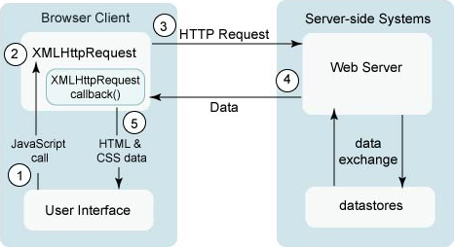
A typical Ajax request
user clicks, invoking an event handler
handler's code creates an XMLHttpRequest object
XMLHttpRequest object requests page from server
server retrieves appropriate data, sends it back
XMLHttpRequest fires an event when data arrives
  this is often called a callback
  you can attach a handler function to this event
your callback event handler processes the data and displays it

Slide 9
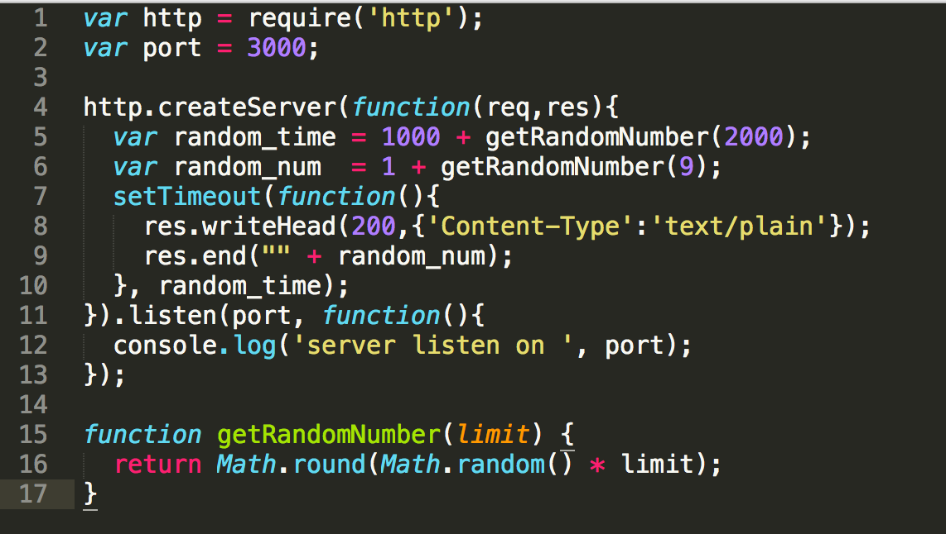
Web services

Slide 10
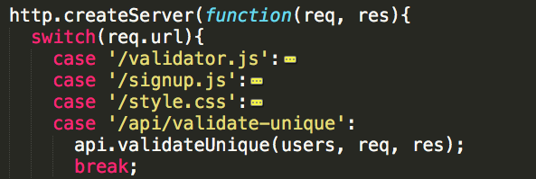
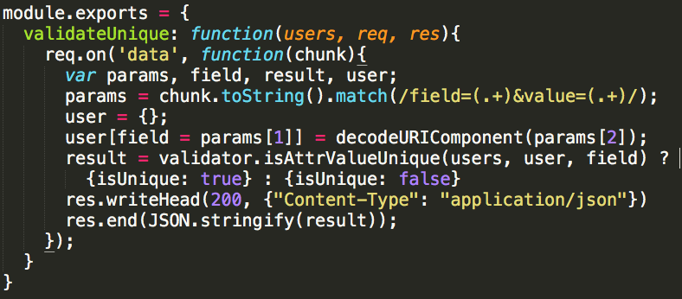
REST

Slide 11
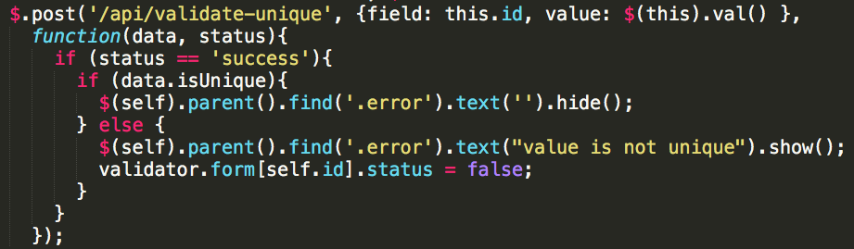
REST

Slide 12
Outline
Ajax, Web services, REST
Async in JavaScript

Slide 13
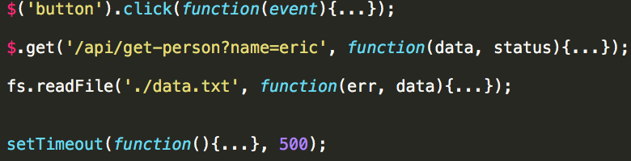
Async in JavaScript
I/O
  event handlers
  ajax calls
  File I/O
setTimeout

Slide 14
Asynchronous Programming
Style of AP
  callAysnc(param1, param2, callback)
  callback(error, result)
Traps of AP
  callback is the return of AP
  order of AP calls
    when need line-up calls, you have to wrap them in callbacks
  Once a async, all async
    when a call in a calling stack is async, all its caller ancestors are asyncs
  don’t throw error, callback error
  this will be lost, use closure instead

Slide 15
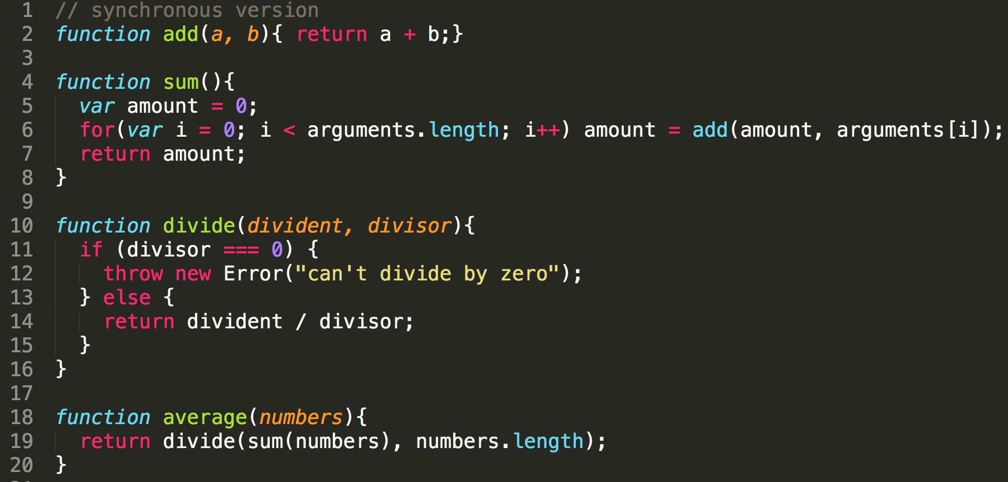
Async. example

Slide 16
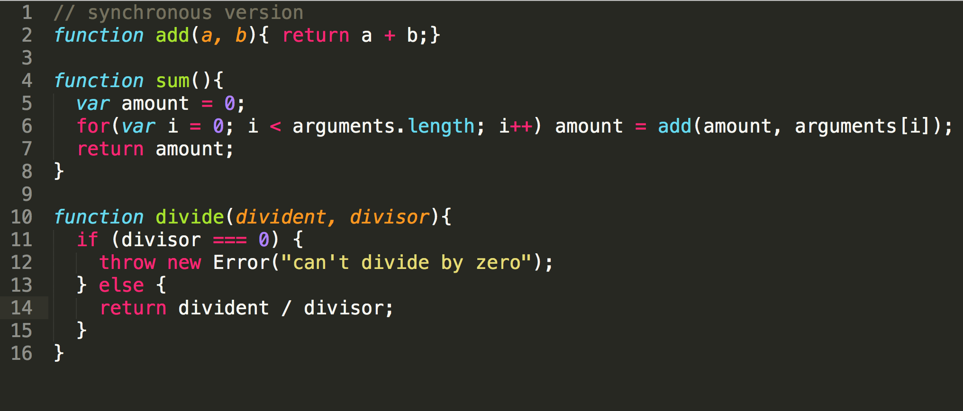
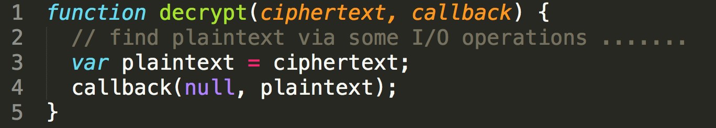
Async. example

Slide 17
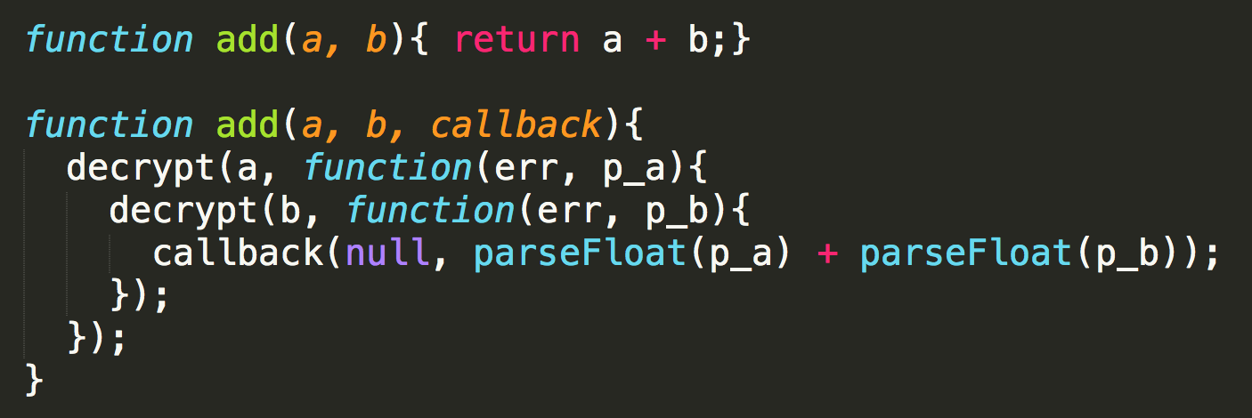
Async. example
callback is the return of AP
line up async calls in nested callbacks
once aysnc, all callstacks above aysnc

Slide 18
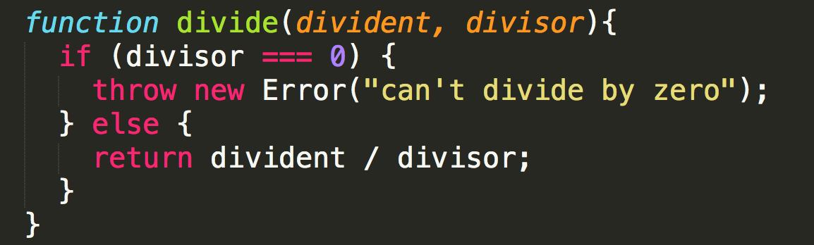
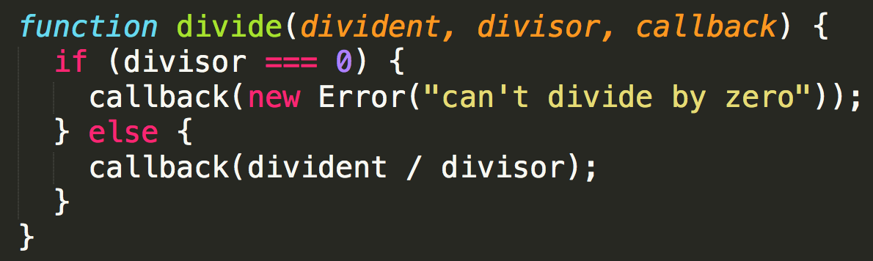
Async. example

Slide 19
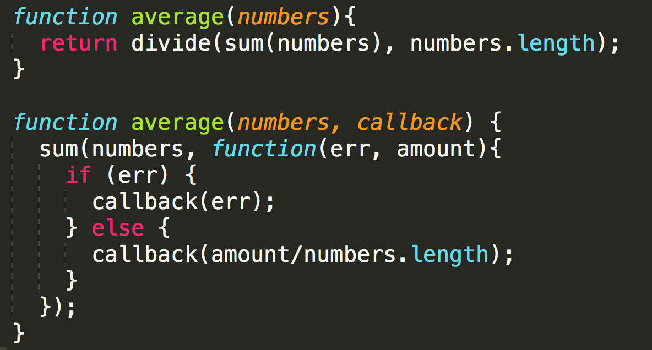
Async can be tricky
don’t throw error, callback error

Slide 20
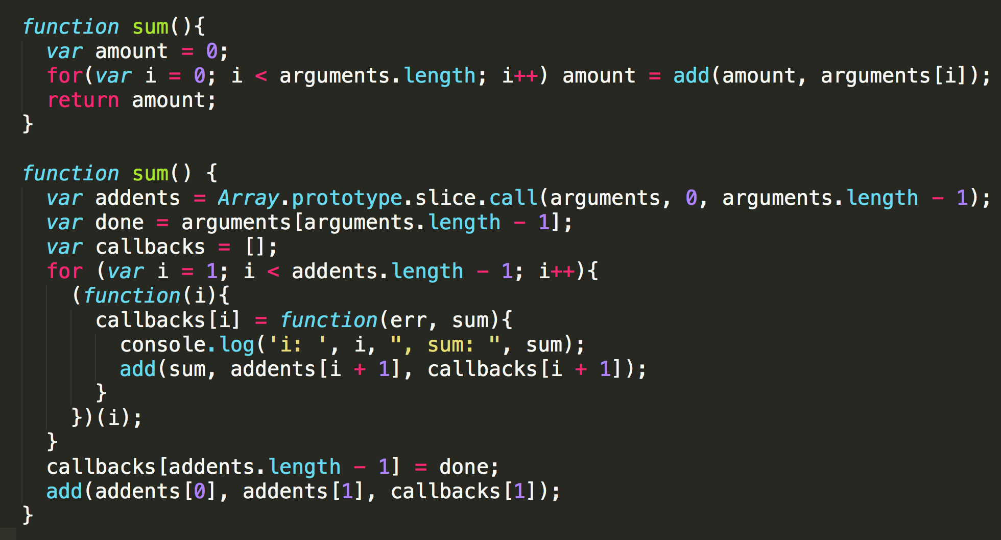
Async can be tricky

Slide 21

Thank you!

